Slide 1

CSE-213
(Data Structure)
Lecture on
Sorting

Slide 2
Sorting
Sorting in Linear Array:
Sorting an array is the ordering the array elements in ascending (increasing from min to max) or descending (decreasing – from max to min) order.
Example:
{2 1 5 7 4 3} => {1, 2, 3, 4, 5,7} ascending order
{2 1 5 7 4 3} => {7,5, 4, 3, 2, 1} descending order
Let A be a list of n numbers. Sorting A refers to the operation of rearranging the elements of A so they are in increasing order.
i.e. so that A[a]<A[2]<A[3]<…....<A[N]
For example,
Suppose A originally is the list
8, 4, 19, 2, 7, 13, 5, 16
After sorting, A is the list
2, 4, 5, 7, 8, 13, 16, 19

Slide 3
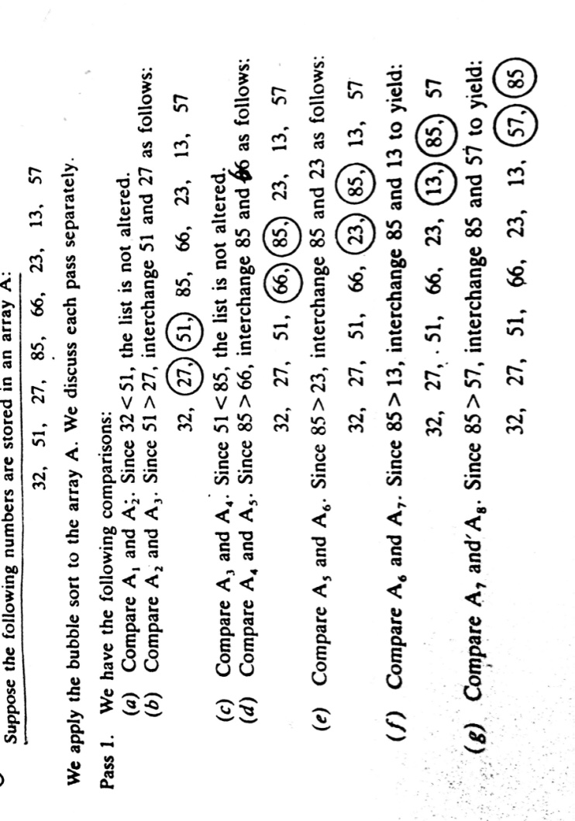
Sorting: BUBBLE SORT
At the end of the first pass, the largest number ,85 has moved to the last position.
Rest of the number are not sorted.

Slide 4
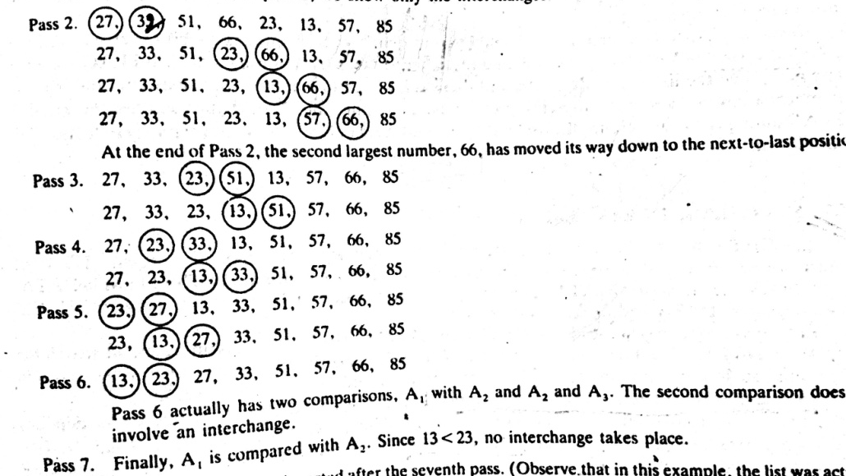
Sorting: BUBBLE SORT
Since the list has 8 elements, it is sorted after the seventh pass.

Slide 5
Bubble Sort: Algorithm
BUBBLE (DATA, N)
(Here DATA is an array with N elements. This algorithm sorts the elements in DATA)
Step 1. Repeat Steps 2 and 3 for K=1 to N-1.
Step 2. Set PTR:=1 [Initialize pass pointer PTR]
Step 3. Repeat while PTR<=N-K [Execute pass.]
(a) If DATA[PTR]>DATA[PTR+1], then:
Interchange Data[PTR] and DATA[PTR+1].
[End of IF Structure]
(b) Set PTR:=PTR+1.
[End of inner loop.]
[End of Step 1. outer loop.]
Step 4. Exit.

Slide 6
Complexity of BUBBLE SORT
Traditionally, the time for this sorting algorithm is measured in terms of the number of comparisons. The number f(n) of comparisons in the bubble sort is easily computed.
Specifically, there are n-1 comparisons during the first pass, which placed the largest element to the last position; there are n-2 comparisons in the second step, which placed the second largest element in the next-to-the last position, and so on. Thus.
F(n)=(n-1)+(n-2)+….+2+1
=n(n-1)/2
=n²/2+O(n)
=O(n²)

Slide 7
Selection Sort
Selection sort is a simple sorting algorithm.
This sorting algorithm is an in-place comparison-based algorithm
List is divided into two parts, the sorted part at the left end and the unsorted part at the right end.
Initially, the sorted part is empty and the unsorted part is the entire list.
The smallest element is selected from the unsorted array and swapped with the leftmost element
This algorithm is not suitable for large data sets as its average and worst case complexities are of Ο(n²), where n is the number of items.

Slide 8





Selection Sort: How it works?
For the first pass: the lowest value 10 is selected and swapped with 14
For the second pass: we start from 33 and scan the list for the second lowest and swap

Slide 9
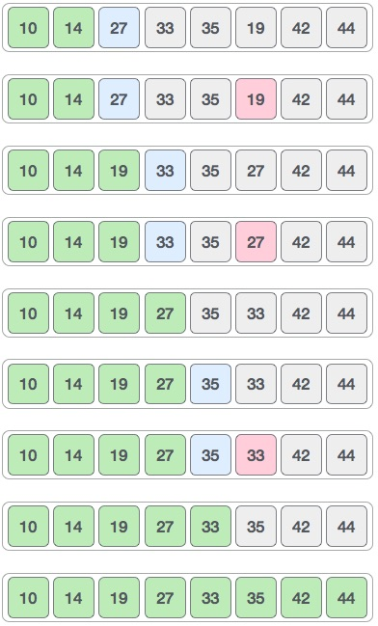
Selection Sort: How it works?

Slide 10
Selection Sort: Procedure
procedure selection sort
list : array of items ; n : size of list
for i = 1 to n - 1
iMIN = i /* set current element as minimum*/
for j = i+1 to n /* check the element to be minimum */
if list[j] < list[iMIN] then
iMIN = j;
end if
end for
/* swap the minimum element with the current element*/
if iMIN != i then
swap list[iMIN] and list[i]
end if

Slide 11
QUICKSORT: An Application of STACKS
Quicksort is an algorithm of the divide-and-conquer type.
The problem of sorting a set is reduced to the problem of sorting two smaller sets.
Quicksort is used to illustrate the application of Stacks
A
44
33
11
55
77
90
40
60
99
22
88
66

Slide 12
Quicksort/ Reduction Step
44
33
11
55
77
90
40
60
99
22
88
66
The REDUCTION STEP of the quick sort algorithm finds the final position of ONE of the numbers
Beginning with the last number, 66, scan the list from right to left till less than 44.
Interchange 44 and 22
Beginning with, 22 , scan left to right till greater than 44
Interchange 44 and 55
Beginning with, 55, scan the list from right to left till less than 44.
Interchange 44 and 40
44
33
11
55
77
90
40
60
99
22
88
66
22
33
11
55
77
90
40
60
99
44
88
66
22
33
11
44
77
90
40
60
99
55
88
66

Slide 13
Quicksort/ Reduction Step
22
33
11
40
77
90
44
60
99
55
88
66
Beginning with, 40, scan left to right till greater than 44
Interchange 44 and 77
Beginning with, 77, scan the list from right to left till less than 44.
Do not meet such a number before meeting 44.
Thus, 44 is correctly placed in its final position.
The task of sorting the original list A has now been reduced to the task of sorting each of the above sublists.
22
33
11
40
44
90
77
60
99
55
88
66
22
33
11
40
44
90
77
60
99
55
88
66
First sublist
Second sublist

Slide 14
Quicksort/ Reduction Step
The reduction step is repeated with each sublist containing 2 or more elements.
Since we can process one sublist at a time, we must be able to keep track of some sublist for future processing.
This is accomplished by using two STACKS
LOWER and UPPER
To temporarily hold such sub-lists.
The addresses of the first and last elements of each sublist, called its “BOUNDARY VALUES” , are pushed onto the STACKs LOWER and UPPER, respectively.
The reduction steps is applied to a sublist only after its BOUNDARY VALUES are removed from the STACKs.
22
33
11
40
44
90
77
60
99
55
88
66
First sublist
Second sublist

Slide 15
STACKS: Illustration of the way the STACKS LOWER and UPPER are used
A
44
33
11
55
77
90
40
60
99
22
88
66
15
N=12 elements,
Thus,
Boundary values are ()?
1 and 12.
Now,
1 and 12 should be Stacked
LOWER:1 and UPPER:12
In order to apply the REDUCTION STEP, the algorithm first removes the top values 1 and 12.
After removing the top values 1 and 12 from the STACK, leaving
LOWER:(Empty) and UPPER: (Empty)
Then Applies the REDUCTION STEP to the corresponding list A[1], A[2],….,A[12].

Slide 16
STACKS: Illustration of the way the STACKS LOWER and UPPER are used
After executing REDUCTION STEP to the list A[1] to A[12]
Finally places the first element 44, in A[5].
Accordingly, the algorithm pushes the boundary values
1 and 4 of the first sublist, and
6 and 12 of the second sublist on to the STACK to yield
LOWER= 1, 6 and UPPER= 4, 12
In order to apply the REDUCTION STEP again, the algorithm removes the TOP values 6 and 12 from the STACKs, leaving
LOWER= 1, and UPPER= 4
22
33
11
40
44
90
77
60
99
55
88
66
First sublist
16
Second sublist

Slide 17
STACKS: Illustration of the way the STACKS LOWER and UPPER are used
A[6] A[7] A[8] A[9] A[10] A[11] A[12]
90
77
60
99
55
88
66
66
77
60
99
55
88
90
66
77
60
90
55
88
99
66
77
60
88
55
90
99
Second sublist
First sublist
The second sublist has only one element, Accordingly
The algorithm pushes only the boundary values 6 and 10 of the first sublist on the STACKs to yield
LOWER= 1, 6 and UPPER= 4, 10

